Slide 1
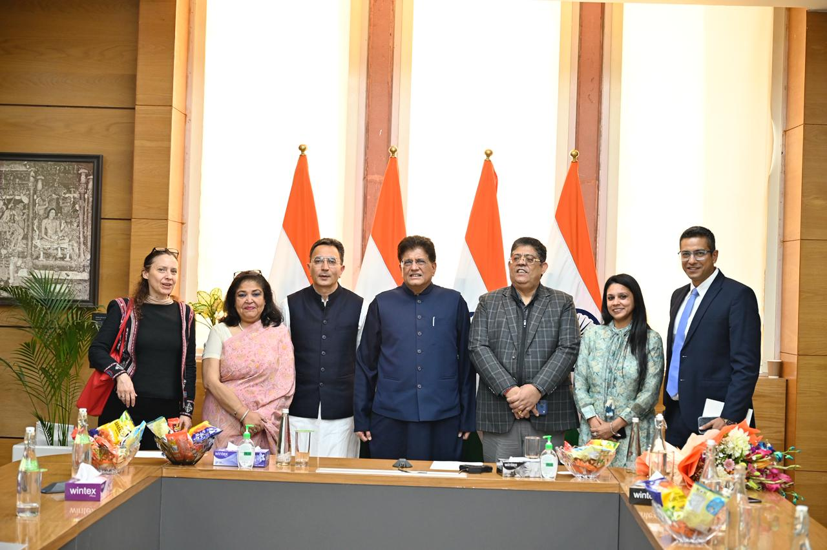

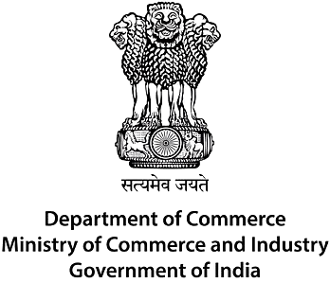
DELEGATION MEETING REPORT
BAA Delegation
Meets Hon'ble
Union Minister
Shri Piyush Goyal
Ministry of Commerce & Industry
Government of India — New Delhi
BAA Delegation with Union Minister Shri Piyush Goyal — New Delhi, 11 February 2026

Slide 2
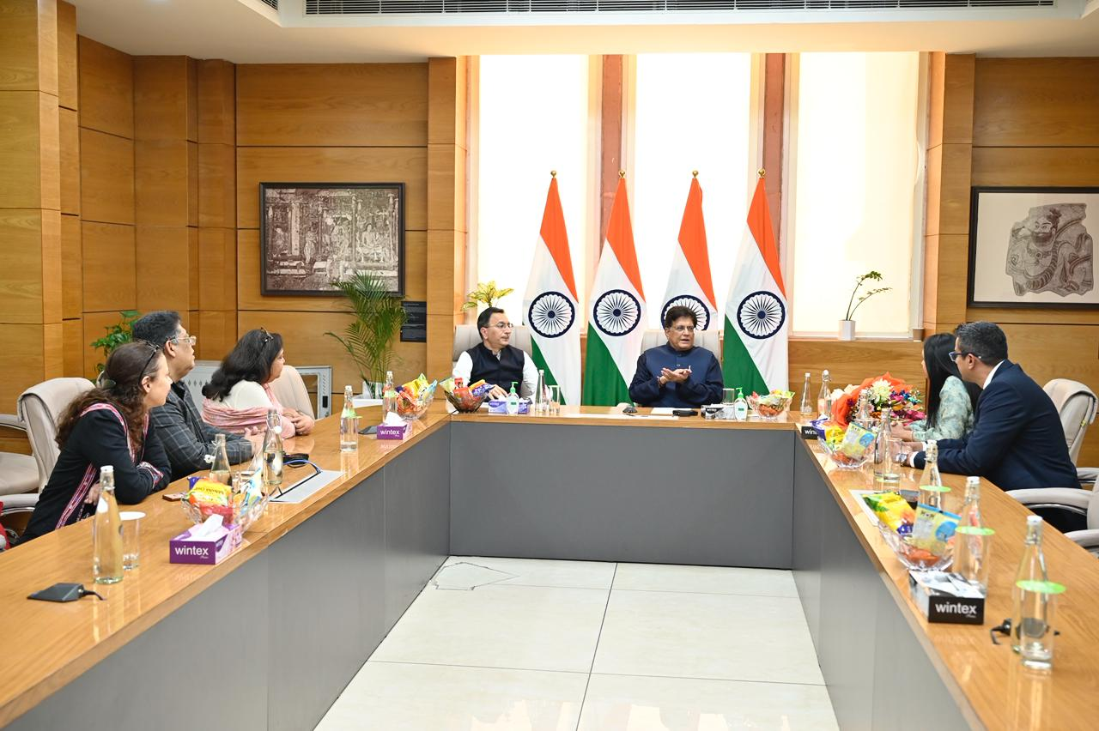
Delegation Overview
About the Meeting
A delegation of the Buying Agents Association (BAA) met with Hon'ble Union Minister Shri Piyush Goyal at the Ministry of Commerce & Industry, Government of India, New Delhi.
BAA DELEGATION MEMBERS
Ms. Ruma Malik
Chairperson, BAA
Ms. Anchal Kansal
General Secretary, BAA
Mr. Pramod Rana
Governing Body Member
Mr. Manoj Rana
Governing Body Member
Mrs. Priya
BAA Member
New Delhi, 11 February 2026
BAA — Committed to Advancing India's Global Trade Ecosystem | info@baa.org.in | www.baa.org.in

Slide 3
Key Discussions
The discussions covered a wide range of critical themes shaping India's trade and export landscape:
01
04
India's FTA Framework
Role of Buying Agencies
BAA congratulated the Government on advancing Free Trade Agreements with major partners including the UK, EU, USA, and others, creating significant new opportunities for Indian exporters.
The delegation highlighted the critical role buying agencies play in the export value chain, acting as the bridge between global buyers and Indian manufacturers.
02
05
Tariff Developments
Policy Alignment
The delegation welcomed tariff reductions with the United States and highlighted their positive impact on India's sourcing and export competitiveness.
BAA underscored the importance of ensuring that policy frameworks reflect the practical realities of international sourcing and the day-to-day operations of buying agents.
03
Indian Quality Mark
BAA emphasized the need for a globally recognized Indian quality mark to strengthen international confidence in Indian goods and boost buyer trust across sourcing markets.
BAA — Committed to Advancing India's Global Trade Ecosystem | info@baa.org.in | www.baa.org.in

Slide 4
India's Next Phase of Trade Leadership
The BAA delegation engaged in a constructive and forward-looking discussion with the Minister on India's evolving trade and export landscape.
Strengthening India's Competitiveness
1
Boosting India's position in global markets through strategic, forward-looking trade policy.
"As India deepens its trade partnerships and expands market access, BAA remains committed to representing the voice of buying agencies and contributing constructively to the nation's export growth journey."
Enhancing the Role of Buying Agencies
2
Amplifying buying agencies' contribution to export growth and facilitating global sourcing partnerships.
FTA Framework into Measurable Gains
3
Ensuring India's expanding FTA framework delivers tangible benefits for exporters, MSMEs, and allied trade bodies.
BAA — Committed to Advancing India's Global Trade Ecosystem | info@baa.org.in | www.baa.org.in

Slide 5
BAA — Committed to Advancing
India's Global Trade Ecosystem
🤝
🌐
📈
Trade Advocacy
Global Connections
Export Growth
Representing buying agencies before Government & policy bodies
Bridging Indian manufacturers with international buyers
Driving India's sourcing competitiveness on the world stage
info@baa.org.in | www.baa.org.in

